Slide 1
SJMHS- Emergency Management
Overview & Concepts

Slide 2
What is the Difference between an Emergency and Disaster?
An EMERGENCY is a sudden, urgent, unexpected event requiring immediate action, usually requiring help. Sufficient RESOURCES ARE AVAILABLE to deal with it.
A DISASTER is a catastrophic event, especially one occurring suddenly and causing great loss of life, damage, or hardship. Sufficient RESOURCES ARE NOT AVAILABLE.
Emergencies can quickly escalate into disasters (depending on type of incident) due to lack of resources, e.g., supplies, staffing, etc. at the local level.

Slide 3
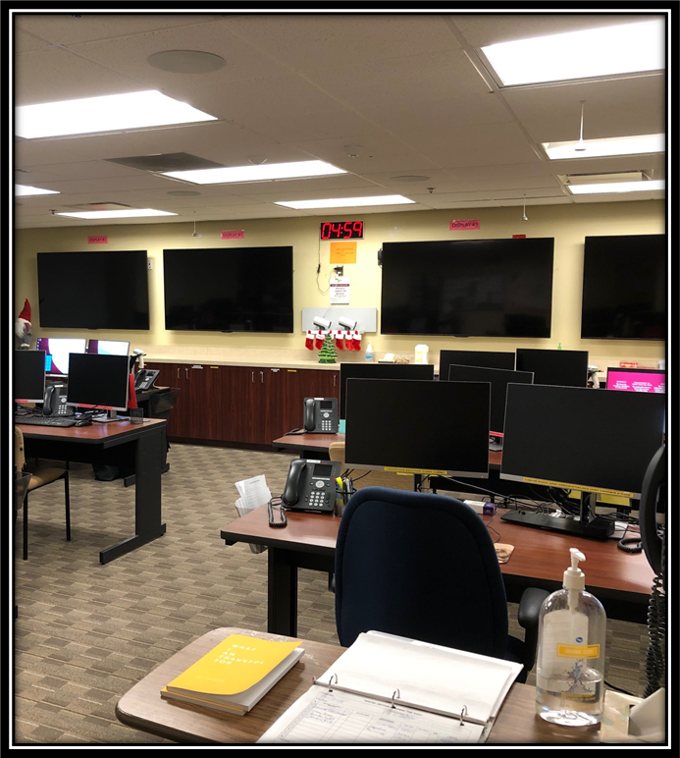

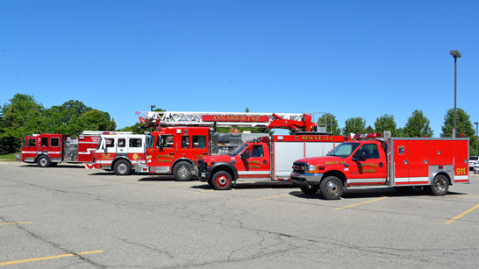
Who Responds to an Emergency or Disaster?
Everyone is responsible to prepare for, protect against, respond to, and recover from, and mitigate any emergency/disaster.
This includes all levels of government, non-government, and private sector organizations, e.g., health care, schools, transportation, etc.
Everyone plays a role. Our goal is shared: Safety and Resilience
Hospital Incident Command Center

Slide 4
Emergency/Disaster Notification
The warning and notification alerts specific to emergencies and disaster events and the procedures to follow when an emergency or disaster incident occur are as follows:
Notification of an emergency/disaster will most likely occur through one of the following methods:
  Notification of emergency services through Emergency Department radio communication.
  Notification by personnel of an emergency/disaster to the regional call center.

Slide 5
Emergency/Disaster Reporting
Any employee who observes or receives information regarding a potential or actual disaster event should report the information internally by:
  From a hospital phone, dial 911.
  From a cell phone or outside line, dial 734-712-0911.
  When reporting the information, ask to activate the incident command alert.
  Identify yourself to the operator and say “This is (give your name) at the (state building name). I need to report an emergency at our facility. Please activate the (state hospital name) Incident Command Alert for me.” Then stay on the line for instructions.
  If dialing 911 from a cell phone, the call will reach a community dispatcher. Offer or request assistance as appropriate.
    If you wish to reach community 911 from an in-house phone, dial 99-911

Slide 6
REVIEW: To Report Emergencies
ON-CAMPUS
OFF-CAMPUS (or mobile)
Notify Regional Call Center:
Dial 911
Report the type of emergency
If you wish to reach the outside 911 from a hospital phone:
99-911 and report the type of emergency, give location and building
Dial 911
Report the type of emergency and give building address

Slide 7
Review: Incident Command Alert (ICA) Process
Incident Occurs
Call 911 and ask to activate an incident command alert
Incident commander on call, key incident command staff, and other key stakeholders gather on conference call
Incident commander gathers information and decides whether to activate the Emergency Operations Plan (EOP)

Slide 8
Emergency/Disaster Activation & Communication
The incident commander will decide whether to activate the Emergency Operations Plan (EOP) on the incident command alert.
  The EOP is a broad hospital disaster response plan.
  All departments are required to have a department-specific response plan. Make sure your team knows your department plan for emergencies/disasters.
If the incident commander decides to activate and operationalize the hospital EOP (disaster response), the hospital incident command center will open (in-person or virtual depending on incident), specific roles will be assigned for the incident management team including those that will carry out communication duties associated with the Communications Plan.
Departments should activate their disaster response plans if appropriate
Depending on the scope and size of the event, the Public Information Officer (PIO) and/or internal communications will be activated.
All communications with the media will be handled through the Public Information Officer. Internal communications are handled through internal communications. All communications will be vetted and approved through the proper Incident Command channels prior to delivery.

Slide 9
What process is used to respond to an escalating emergency or disaster?
The Hospital Incident Command System (HICS)
  An incident command system (ICS) designed for hospitals
  HICS is the same process as the incident command system (ICS) used by our local partners. HICS has some extra roles for response that are applicable to healthcare.
  Intended for use in emergency and non-emergency situations such as: full scale exercises, concerts, large events and projects, etc.
  Assists in emergency management planning, response, and recovery capabilities
  It is a standardized approach to incident management for effective and efficient coordination among hospitals and local responders
  Guides all levels of government, nongovernmental organizations, and the private sector to work together
  Provides shared vocabulary and clear reporting channels

Slide 10
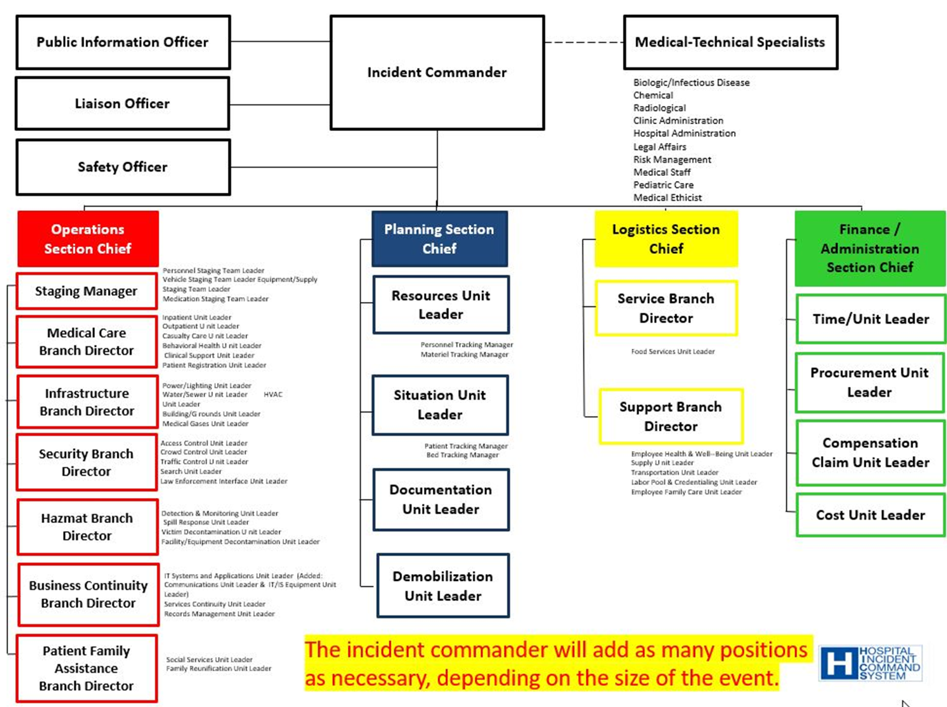

Slide 11
Disaster Reporting/Response Structure
All response efforts begin and end at the local level.
When resources are overwhelmed at the hospital level, the regional healthcare coalition will be contacted.
Regional Healthcare Coalitions collaborate with state partners to assist the hospitals.
If state resources are overwhelmed, the state will work with federal partners to assist and those resources go back down to the state, regional healthcare coalitions, and then reach the hospitals.
Federal
State
Local
Regional Healthcare Coalitions

Slide 12
Obtaining Resources & Assets in a Disaster
Incident Command will assist with obtaining resources and supplies (equipment, staffing, etc.) in real events.
These can be obtained by emailing the appropriate incident command email address:
  aaic@trinity-health.org for Ann Arbor/Canton
  chic@trinity-health.org for Chelsea
  lvic@trinity-health.org for Livingston/Brighton

Slide 13
What Happens After Real Events?
Emergency Operations Plan is deactivated, and Incident Command closes when situation is stabilized
All disaster privileges end when the EOP is deactivated

Slide 14
How do we Document & Learn from Real Events?
After Action Report/Improvement Plan (AAR/IP)
Emergency Management is required to do create a written document called an After Action Report and Improvement Plan to capture what went well and key lessons learned, including recommendations for improvement
Sharing AAR/IP
Anyone involved in event
Regulatory agencies
FEMA – federal funding
AAR/IP is not closed until every after-action item is complete
Groups/Teams are formed for improvement planning to follow up on each after action item identified
Update Plans
Update disaster plans as needed from lessons learned
Debriefing occurs to identify what went well and lessons learned

Slide 15
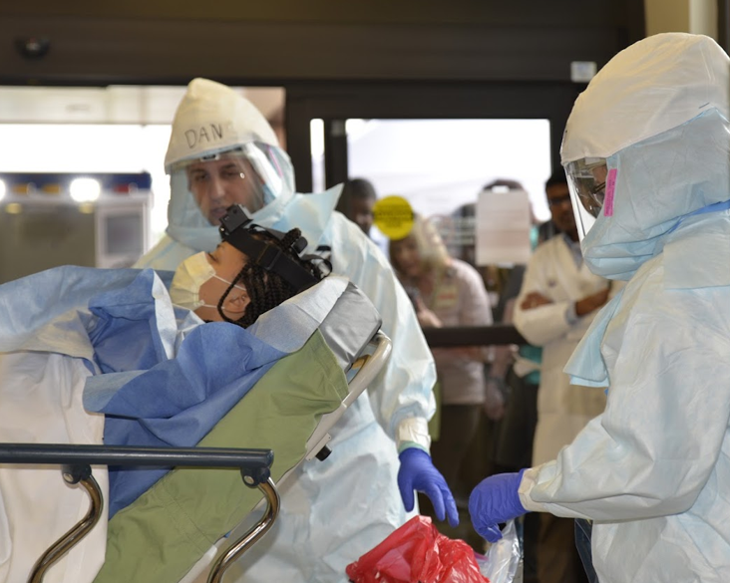

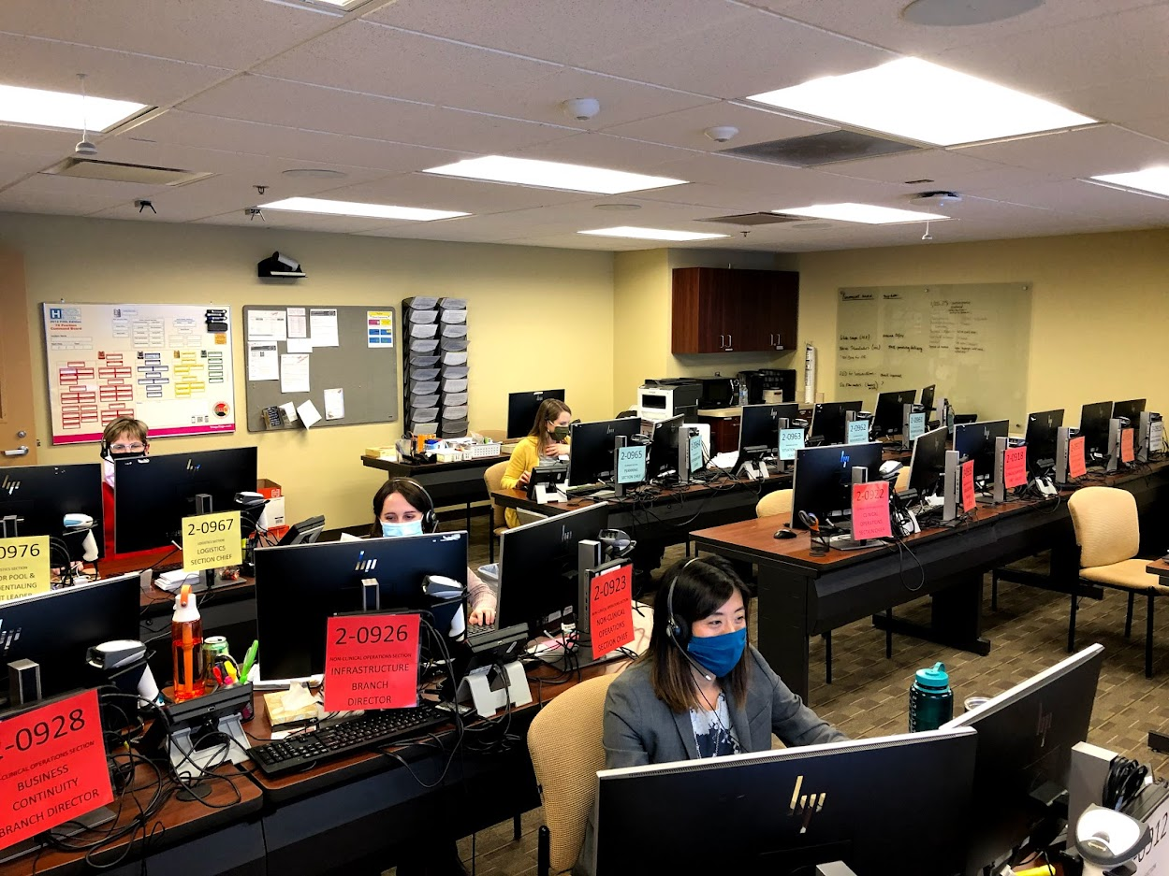
Planned Events & Exercises
Required to do 2 exercises each year and 1 of them must be an Operational Based Exercise
Functional (FE)
Patient Movement
Activation of incident command
Real events can count as a Full-Scale Exercise
“Boots on the ground” response (e.g., EMS, law enforcement, fire, mock victims/patients)
Full Scale Exercise (FSE) - as close to the real deal as you can get
Test specific procedures
Coordination among community partners
Debriefing occurs
Involves community partners
Must be documented fully in an AAR/IP
Update disaster plans as needed from lessons learned

Slide 16
Plain Language Review

Slide 17
Plain Language
Hospitals use plain language for emergencies
The only color code is CODE BLUE
Event | Overhead Announcement "Your attention please..."
Disaster | "[Ministry] is responding to a(n) [specific] disaster. More information to follow."
Fire Alarm | "There is a fire alarm activation in[floor/unit/department]"
Code Blue | "There is a Code Blue in [floor/unit]"
Medical Emergency | "There is a medical emergency on [floor/unit/dept]"
Rapid Response | "There is a rapid response needed in [floor/unit]"
Severe Weather Event | "There is a [severe weather event] [watch/warning] in effect until [time]"
Missing infant or child and description | "There is a missing [child/infant]. [Description]"
Missing patient and description | "There is a missing patient. [Description]."
Security assistance required and location | "Security assistance is required in [location]"
Active Shooter and location | "There is an active shooter in [location]"

Slide 18
What to do in a Fire Alarm Activation
At Fire Scene, use R.A.C.E. to guide your actions:
  Rescue
  Alarm
  Close doors
  Extinguish / Evacuate
Also be sure to:
  Reassure patients
  Close doors
  Clear hallways

Slide 19
In a Fire Alarm Activation
DO NOT use elevators
MOVE EQUIPMENT on wheels in the hallways to one side (or to alcoves)
Make sure exits, extinguishers, and fire pull stations are not blocked
Remember: Never store items above 18’’ from the sprinkler head or below ceilings in rooms without sprinklers

Slide 20
Code Blue
If you find someone UNCONSCIOUS / UNRESPONSIVE:
  Notify the Regional Call Center
      Utilize Code Blue button on phone, if applicable
Begin CPR if needed and if qualified
Obtain / Utilize AED if available
Remain until help arrives (team or ambulance)

Slide 21
Medical Emergency
If you find someone CONSCIOUS and RESPONSIVE (i.e., fall, hypoglycemia episode, seizure):
  Notify the Regional Call Center
  Remain until help arrives (dependent on location)
  If their status changes, update Regional Call Center

Slide 22
Missing Patient
If you are unable to find a patient, notify regional call center and ask the operator to initiate a “Missing Patient” and provide unit location and appropriate description.
  ALL Staff: Monitor all exit locations, stairwells and elevators for persons who look lost or confused and are attempting to exit the building wearing a patient gown, street clothes, or have on a patient identification armband or bandages.
  If staff suspect they have found the patient, ask the patient their name and if they can help return them to their room. Contact security and provide their location.
If the patient is at all hostile or aggressive, notify security and do not attempt to physically stop the individual.
  If the patient does leave, note helpful information: vehicle license plate, type of vehicle, direction of travel, description of person they are with, etc.
  Document the episode in the EMR and VOICE.
Behavioral Medicine Unit, Chemical Dependency Unit, and Birthing Center have locked doors and restricted access onto the unit.
  Do not open the unit doors for anyone, even if they have a badge. Unit staff will assist visitors and determine appropriate access to the unit.
  When exiting the unit, check for patients in the hallway. If there is a patient nearby, press the intercom button and ask staff to redirect patients away from the door area before you open the door.
  Check to make sure the door closes behind you. The door will make a click sound when lock-reactivates.

Slide 23
Weather-Related Threats
When a weather-related threat occurs, you will hear:
"There is a [severe weather] [watch/warning] is in effect until [time]”
Patient Care Areas:
      Close the drapes/shades
      Check on and reassure patients
      Follow your departments severe weather plans
Non-Patient Care Areas:
      Close the drapes/shades
      Go to inner hallways away from windows
Listen For Updates

Slide 24
Security Assistance Required
You may need to act if you are concerned that a situation may escalate to a threat of harm or violence.
If you or others are in IMMEDIATE DANGER
      Move those in danger to safety
      Notify Regional Call Center that Security Assistance is needed (give location/description)

Slide 25
Other Threats
Notify regional call center and give specific details to the operator
Overhead announcements and instructions will be provided when appropriate
Disaster Response (Hospital Incident Command) will be activated as needed
Evacuate only if instructed to do so

Slide 26
Evacuation & Sheltering-in-place

Slide 27
Types of Evacuation
Horizontal Evacuation: This level of evacuation involves moving patients who are in immediate danger away from the threat. Patients remain on the same floor of the hospital as the area that they are evacuating. Horizontal evacuation typically involves moving patients to an area of refuge in an adjacent smoke/fire zone or in some cases, at the opposite side of the building. Most evacuations of a single department or patient care unit can be done horizontally, which is the fastest option and has the simplest re-entry process. Evacuation of an entire building may even be accomplished horizontally if every floor of the evacuated building connects to another building.
Vertical Evacuation: This level of evacuation refers to the complete evacuation of a specific floor in a building. In general, patients and staff evacuate vertically towards ground level whenever possible. Moving patients and staff to lower levels helps to prepare for total or full evacuation of the facility should the situation worsen. For most localized incidents, vertically evacuated patients and staff are sent to an area of refuge elsewhere in the hospital typically at least two floors away from the incident floor. During the vertical evacuation of one floor, other floors may be ordered to shelter-in-place or prepare only for their own evacuation.
Total or Full Evacuation: This level of evacuation is used only as a last resort and involves a complete evacuation of the facility. There are many different ways that a total or full evacuation can be planned for and managed.

Slide 28
Shelter-in-place
This level of evacuation requires ending all routine activities in preparation for an impending threat, such as a tornado or toxic cloud. Specific preparations should be made to mitigate against the anticipated threat.
In general, during a no-notice event, patients, visitors and staff remain where they are until they receive further instructions.
Closing doors/windows provides initial protection from fire, smoke, and other hazards.
During a shelter-in-place response, preparations should also be taken to enable immediate evacuation of patients should the situation change, and evacuation become necessary.

Slide 29
Staff Response and Notification
Depending on the threat, staff may need to stay in place or initiate evacuation out of the affected area.
  Hospital staff facing imminent danger from outside sources should stay in place.
  Hospital staff facing imminent danger from smoke, fire or infrastructure damage, should move out of the immediate area.
In both instances, staff need to report the emergency immediately. Inform area leadership of the event requiring sheltering in place or evacuation and activate the incident command alert (ICA).

Slide 30
Patient Information
In the event of an emergency/disaster or evacuation, the method for sharing and/or releasing location information and medical documentation for patients under the hospital’s care are consistent with requirements of law or regulation.
Policy links below address disclosure of protected health information to the following individuals or entities:
  Patient’s family, representative, or others involved in the care of the patient
  Disaster relief organizations and relevant authorities
  Other health care providers
ICP.3 Use and Disclosure of Protected Health Information
ICP.11 Individual Rights Regarding Restrictions and Confidential Communications
ICP.16 Verification of Individuals Requesting Access or Disclosure of PHI

Slide 31
Evacuation Equipment

Slide 32
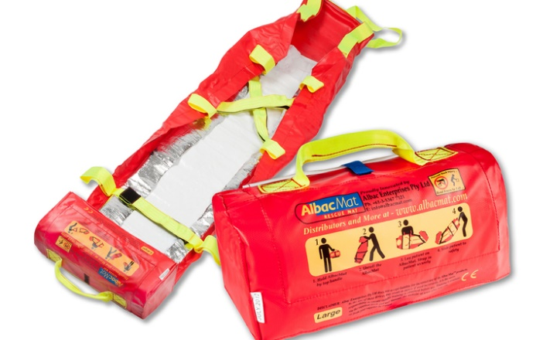
SJMHS: AlbacMat Rescue Mat Training Module
Evacuation Device for Non-Ambulatory Patients
Requiring Vertical Evacuation
At the conclusion of this module, you will be able to:
Verbalize when to use the AlbacMat vertical evacuation mat
Demonstrate how to employ the mat
How to clean the mat after use

Slide 33
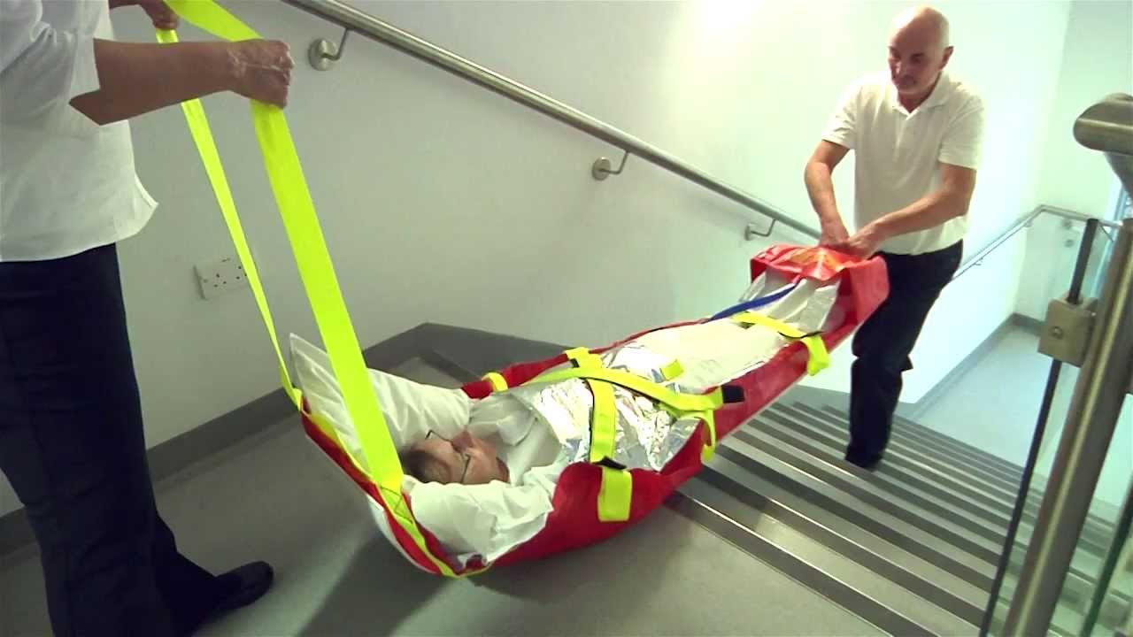
AlbacMat
In an emergency situation, unit leadership in collaboration with Incident Command when appropriate, will assess risk to patient safety and activate the appropriate level of evacuation for the situation when an immediate threat is apparent.
If a threat cannot be contained, horizontal evacuation is the first stage of evacuation. This may require movement of some patients beyond hallway fire doors within the unit or movement of patients to the ‘sister unit’ on the same level when available. If it is determined that a vertical evacuation is necessary, evacuation of non-ambulatory patients down stairways will be required.
The AlbacMat rescue mat is designed specifically for transporting the non-ambulatory patient during a vertical evacuation.

Slide 34
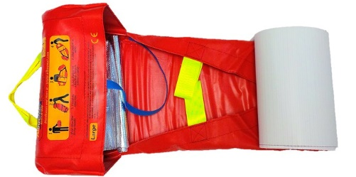
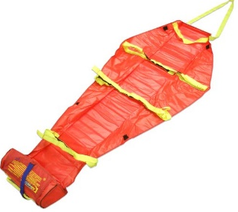
AlbacMat Features
Flexible stretcher that includes:
  Polypropylene flexible base board bottom that glides smoothly over most interior and exterior surfaces, provides insulation to protect the patient and helps absorb impact from rough terrain
  3 fluorescent yellow Velcro cross straps to secure the patient and provide detection in dim lighting
  Pulling handle at the head end and positioning handle at foot end
  Carry handles, 3 on each side for 6-8 person assist if required
  Foot rest pocket for comfort and security of patient within device
AlbacMat is self-contained in its own storage bag weighing (~4½ lbs.)
The bag portion of the mat becomes the foot pocket when in use
Mats accommodate 1000 lbs. Large mats should not be used
for bariatric patients due to their smaller size.
Simple instructions clearly visible on self-storage pocket

Slide 35

Storage Locations
For Ann Arbor, Mats will be stored on each patient floor, 2-11, in the Equipment Alcoves. No mats are required for 1E due to direct access to the outside.
Each Equipment Alcove will have a sign posted at the hallway entrance to indicate AlbacMats are stored within.
If space allows, AlbacMats will be stored in red soft hanging holders that neatly store 4 mats. If space is limited, mats will be placed on equipment shelves within the alcove.
For Livingston & Brighton, Mats will be stored on patient floors 2 and 3, in the equipment cabinets.
For Chelsea, Mats will be stored on Atrium East, Atrium West, the ICU, and Endo/Pain, in the equipment rooms.
In an emergency evacuation requiring vertical transport of patients, mats will need to go to where the patient needs are. Mats stored on one floor that are not needed by patients on that floor, should be shared with other floors upon request.

Slide 36

Care of the AlbacMat After Use
AlbacMats can be used more than once if there is no structural damage or excessive soiling that cannot be cleaned after use. After use, the AlbacMat should be wiped down with antibacterial wipes.
After Use Cleansing:
Obtain PPE: Gloves (Gown/mask/face shield as needed)
Disinfect all surfaces of the mat using antibacterial wipes:
Gray top for after use by non-isolation patients
Orange top with bleach for after use by isolation patients
Ensure cleaning agent remains wet on the surface for the appropriate contact time:
3 min for Gray top wipes 4 min for Orange top wipes
Dispose of gloves and wipes in the trash
Perform hand hygiene
Mats should dry completely prior to repackaging into their built-in bag and returned to their storage location.

Slide 37
Additional Post Use Facts
If there is excessive soiling of the mat during use, mats can initially be cleaned by hosing off the mat with water or thoroughly wiping mat clean with a damp cloth.
  Next, towel dry mat to remove the excess water
  Allow mat to completely air dry
  Use antibacterial wipes to do final cleansing of mat. Use of undiluted chemicals is not recommended.
Do not roll up and store the AlbacMat until it is completely dry.
Visually check the mat after each use or washing. Check the stitching, Velcro straps, base board (bottom) and pulling handles. If any damage has occurred the AlbacMat should be replaced.
If bodily fluids have leaked onto the webbing straps and cannot be removed, it is recommended that the AlbacMat be replaced to prevent cross-contamination during future use.

Slide 38
Using the AlbacMat
View the video demonstration of how to set up and properly deploy the AlbacMat
Need link Video Training

Slide 39
Find out More

Slide 40
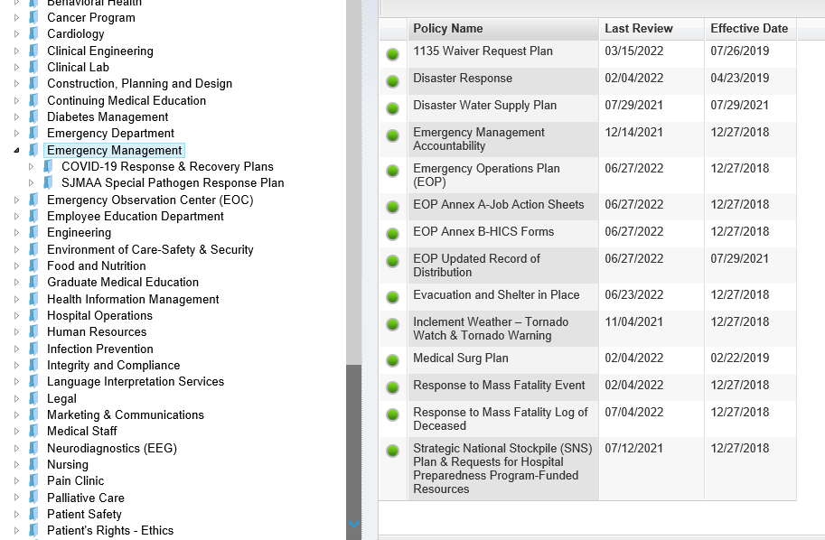
Where do I find Emergency Management Plans?
All emergency management plans, policies, and procedures can be found in Policy Manager under Emergency Management

Slide 41
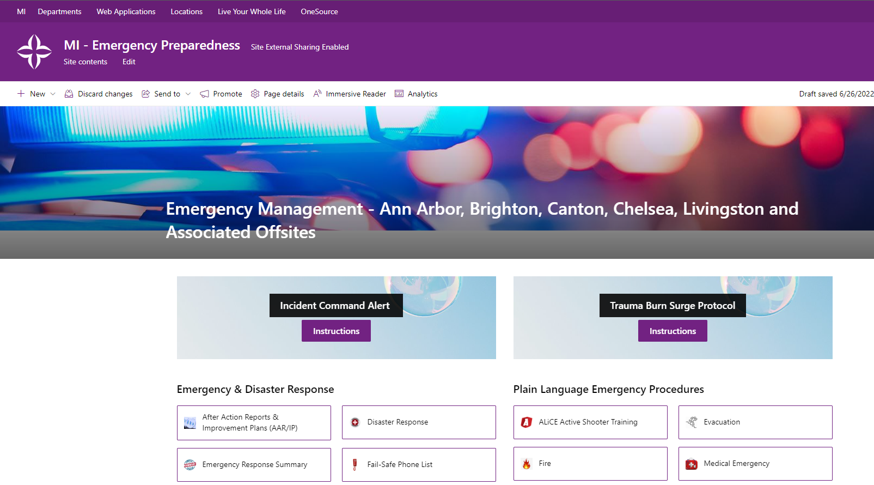
Where can I find out more about Emergency Management?
Emergency Management - Ann Arbor, Brighton, Canton, Chelsea, Livingston and Associated Offsites

Slide 42
Emergency Management Contacts
Denise Bechard, Manager, Emergency Management, Denise.Bechard@trinity-health.org
Jacquelyn Smith, Emergency Management Coordinator, Jacquelyn.Smith@trinity-health.org

